Slide 1
CSE 205
Digital Logic Design
Lecture 3
Dr. Mahmuda Naznin

Slide 2
This Lecture
Review of last lecture: Gate-Level Minimization
Continue Chapter 3:Don’t-Care Conditions, Implementation

Slide 3
Gate-Level Minimization
The Map Method:
A simple method for minimizing Boolean functions
Map: diagram made up of squares
Each square represents a minterm

Slide 4
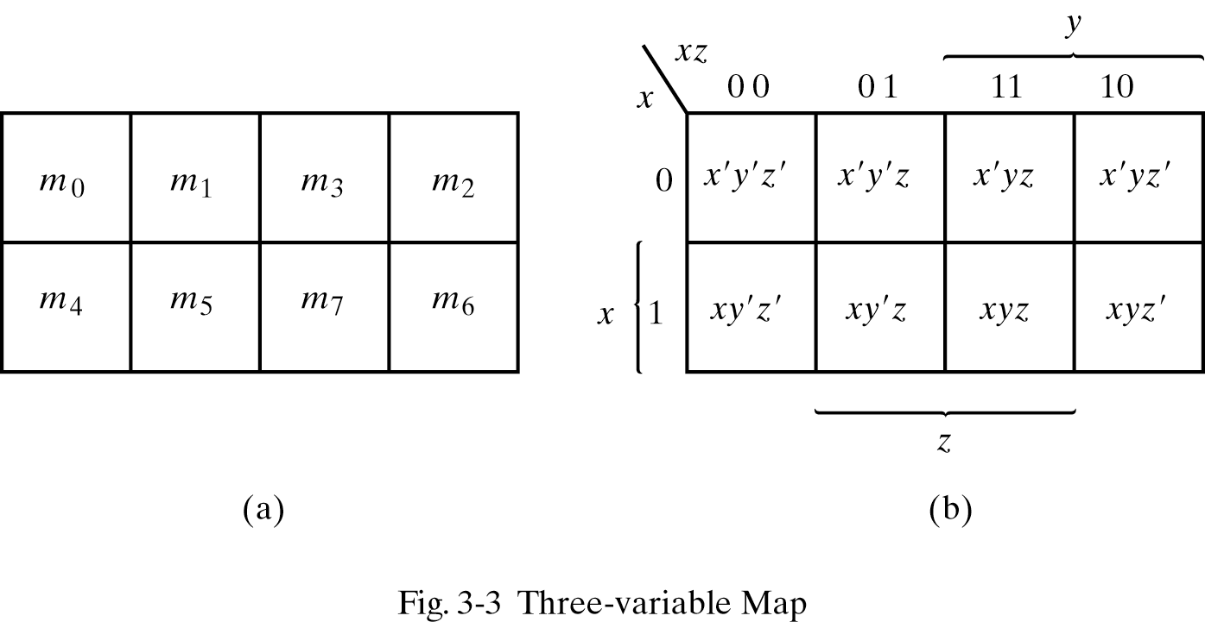
Three-Variable Map
Each variable is 1 in 4 squares, 0 in 4 squares
Each variable is 1 in 4 squares, 0 in 4 squares
Variable appears unprimed in squares equal to 1
Variable appears primed in squares equal to 0

Slide 5
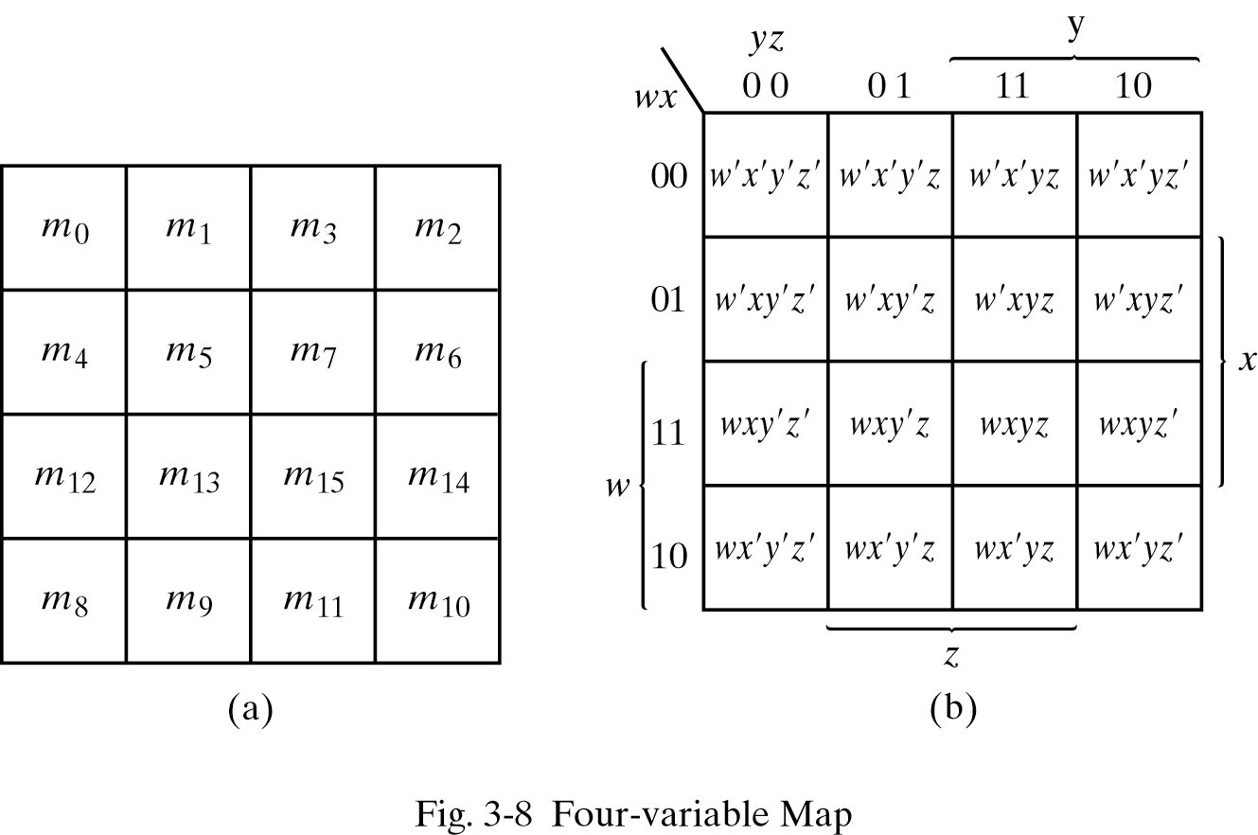
Four-Variable Map

Slide 6
Five-Variable Map
Maps for more than four variables are not easy to use.
Five-variable maps require 32 squares.
Alternative: Use two four-variable maps to make a five-variable one
Minterms 0 to 15 in one map. 16 to 31 in the other one.

Slide 7
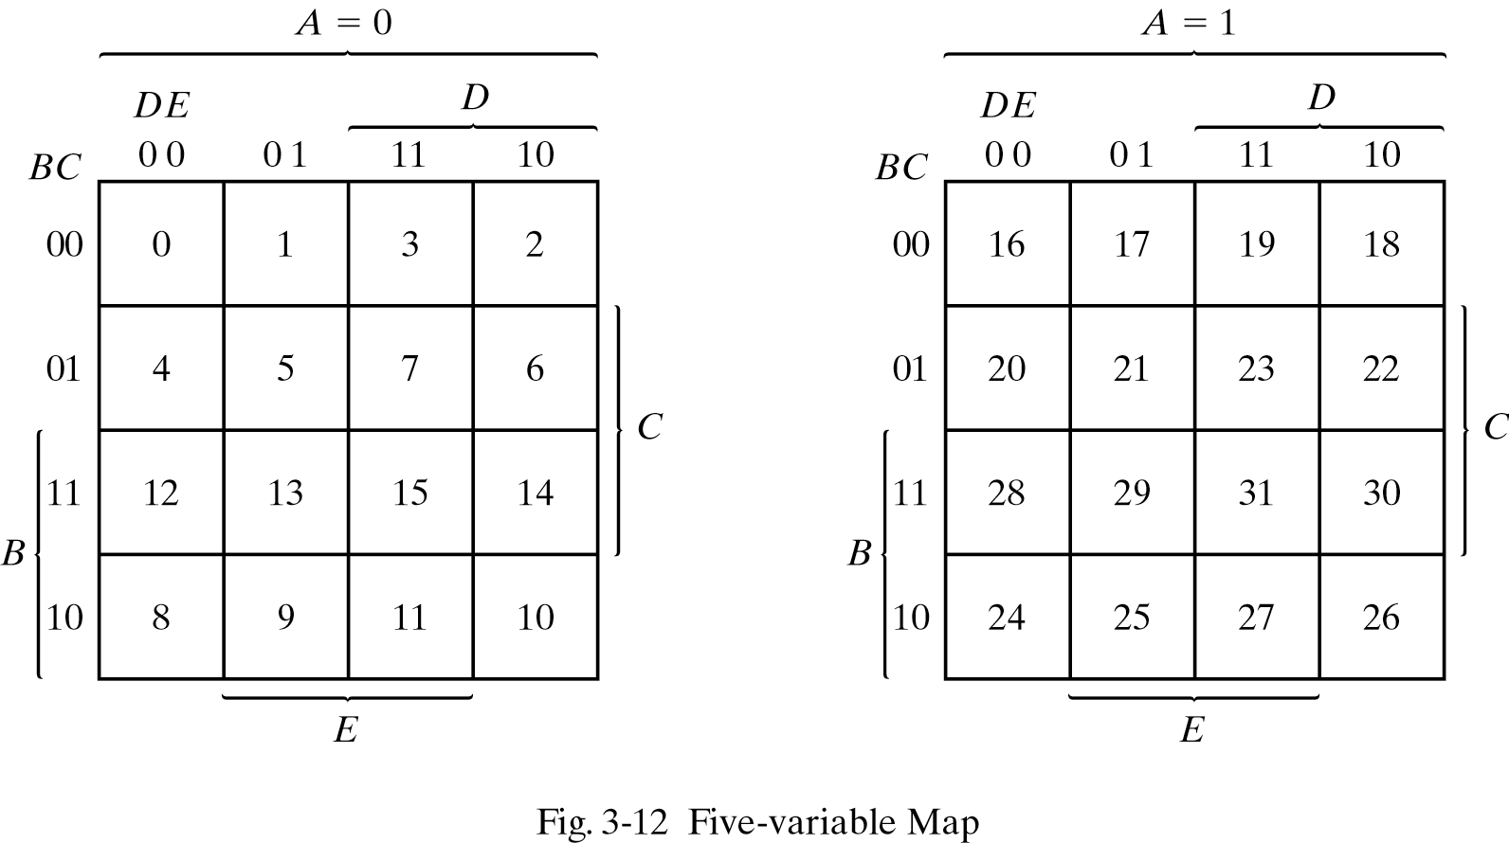
Five-Variable Map
Each square in the A=0 map is adjacent to the corresponding one in the A=1 map.

Slide 8
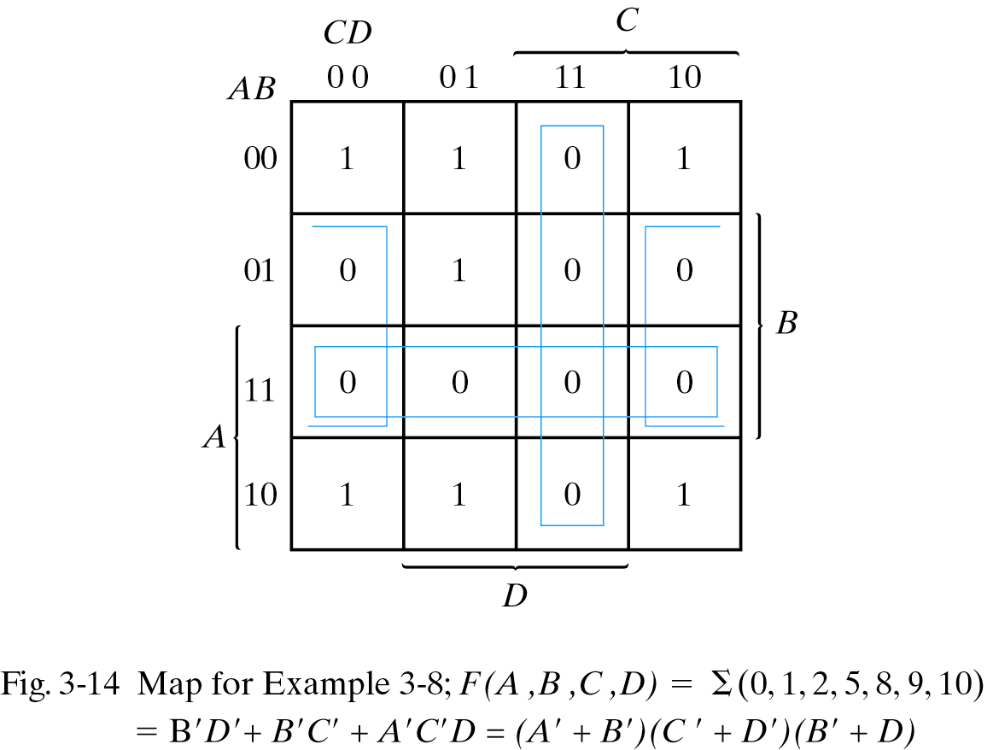
0’s in the map
For a function F, combining the 0 squares gives us F’.
By using F’ and the DeMorgan’s law, we can simplify the function to product of sums.
F’=AB+CD+BD’

Slide 9
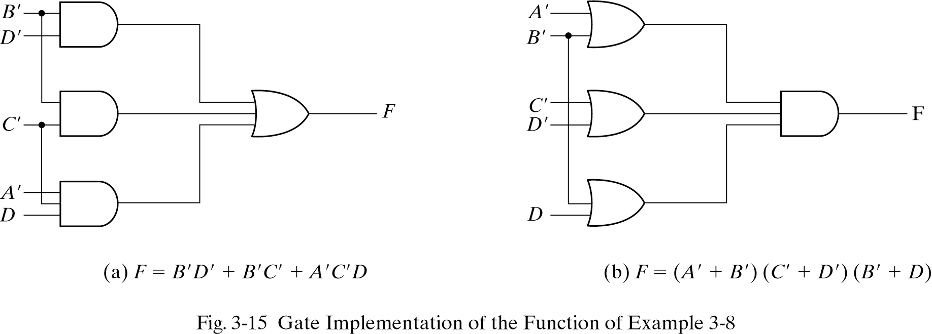
Gate implementation-example 4
SUM of Products Products of Sums

Slide 10
Don’t-Care Conditions
There are applications that the function is not specified for certain combinations and variables.
Mark don’t-cares with X, assume either 1 or 0 to simplify the function.

Slide 11
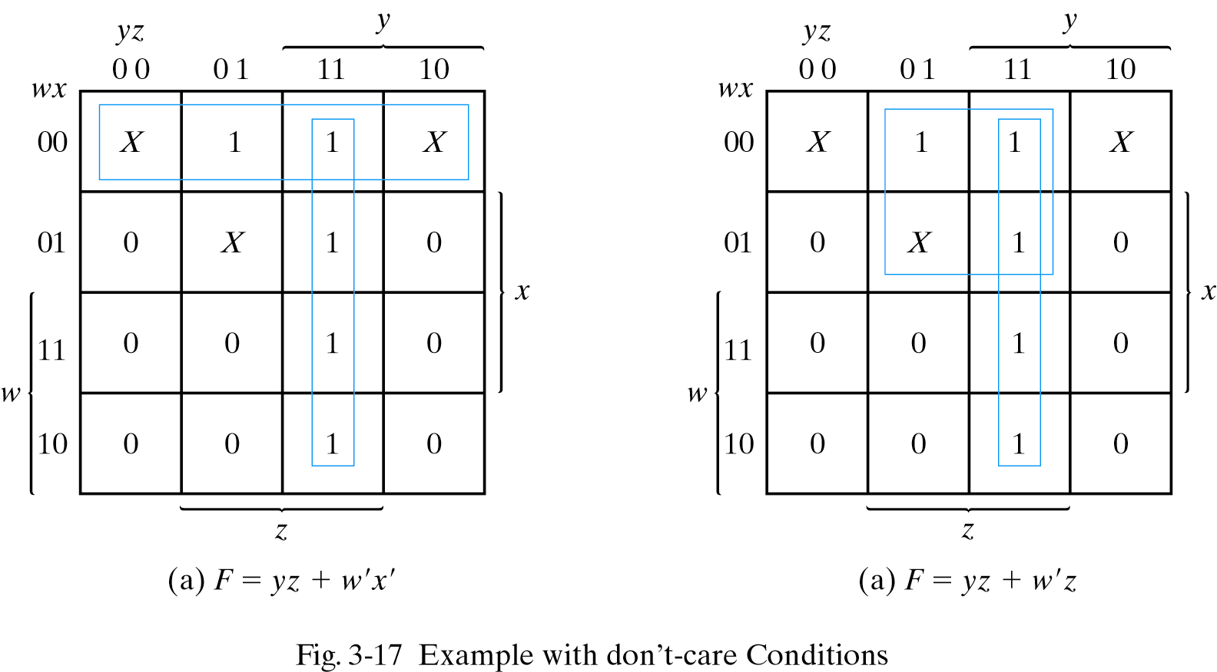
Don’t-Care Conditions
Simplify the Boolean function F(w,x,y,z)=Σ(1,3,7,11,15) which has the don’t-care conditions
d(w,x,y,z)= Σ(0,2,5)

Slide 12
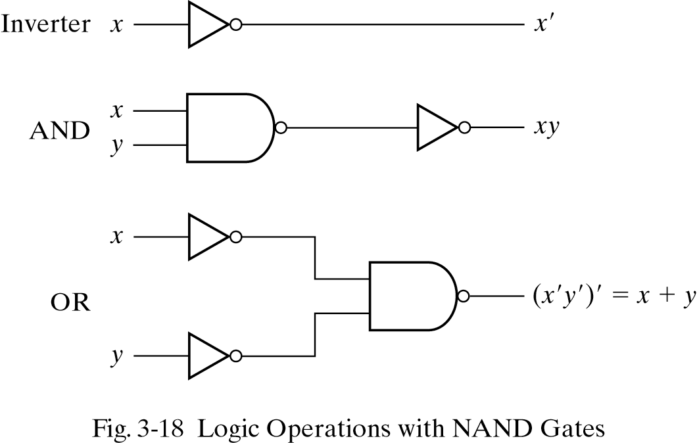
NAND and NOR implementations
Ease of fabrication:
Digital circuits are made of NAND or NOR, rather than AND and OR gates.
We need rules to convert from AND/OR/NOT to NAND/NOR circuits.
NAND gate is a universal gate because any digital circuit can be implemented using it.

Slide 13
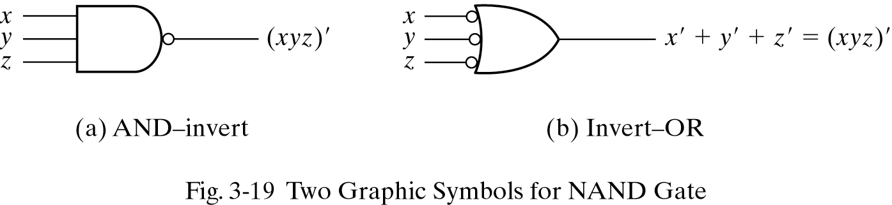
Graphic symbols for NAND gates

Slide 14
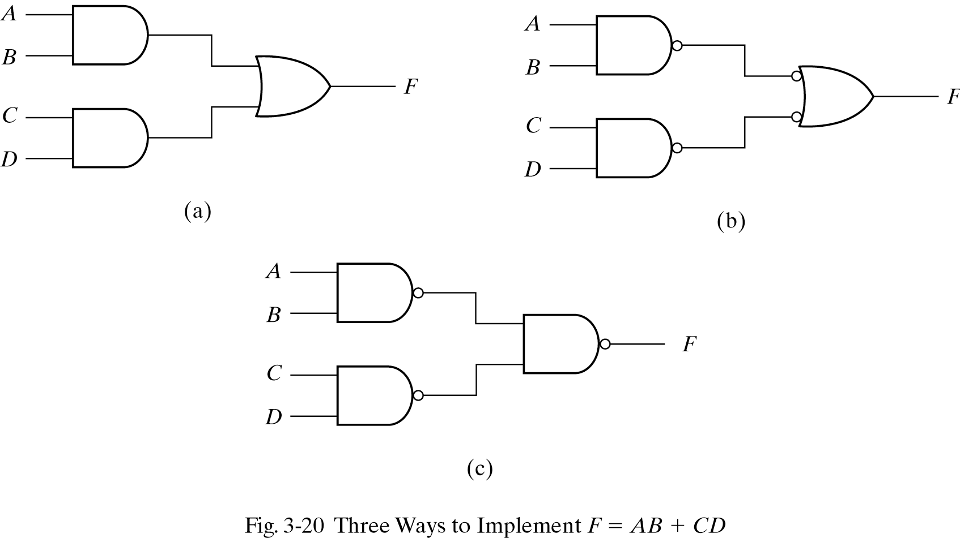
Two-Level Implementation
Three implementations for A.B+C.D

Slide 15
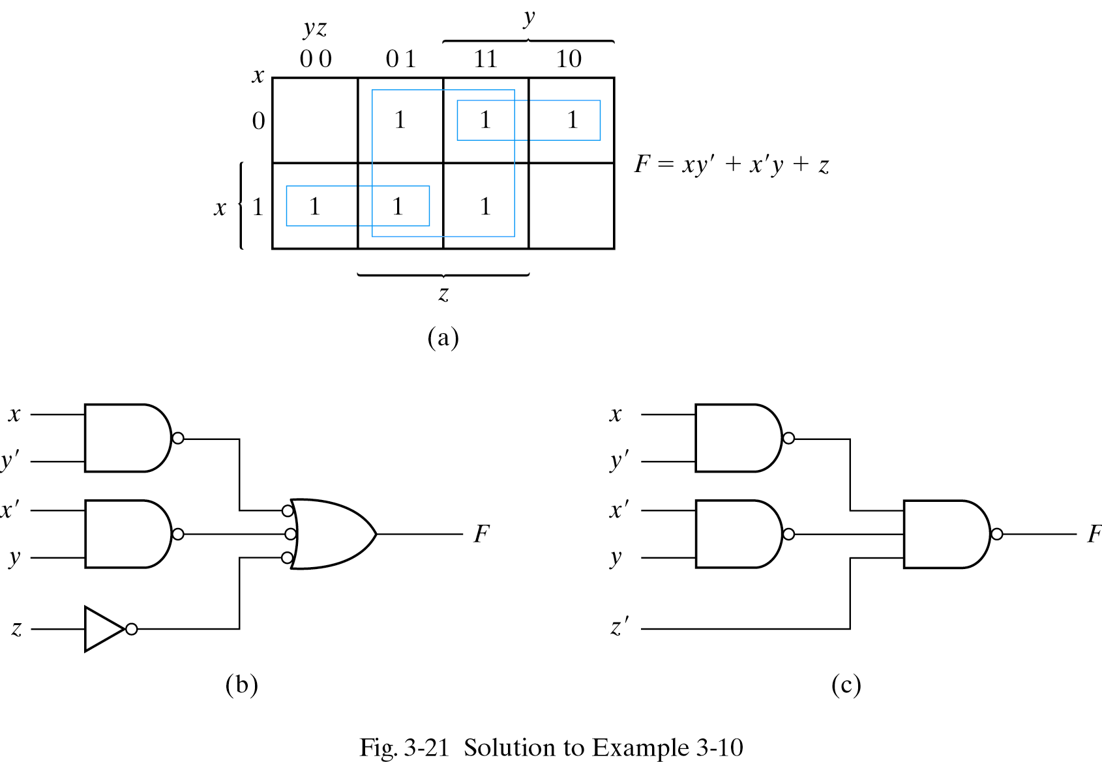
Example
Implement the following function with NAND gates: F(x,y,z)=(1,2,3,4,5,7)

Slide 16
Multilevel NAND circuits
Sum of Products and Product of Sums result in two level designs
Not all designs are of two-levels e.g., F=A.(C.D+B)+B.C’
How do we convert multilevel circuits to NAND circuits?
Rules
1-Convert all ANDs to NAND gates with AND-invert
2-Convert all ORs to NAND gates with invert-OR
3-Check the bubbles, insert bubble if not compensated

Slide 17
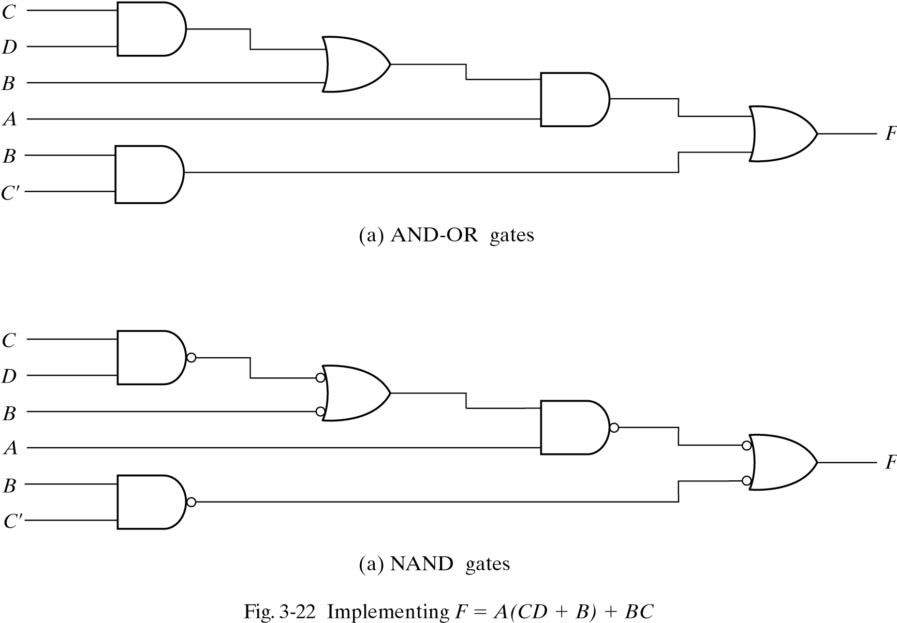
Multilevel NAND circuits
BC’

Slide 18
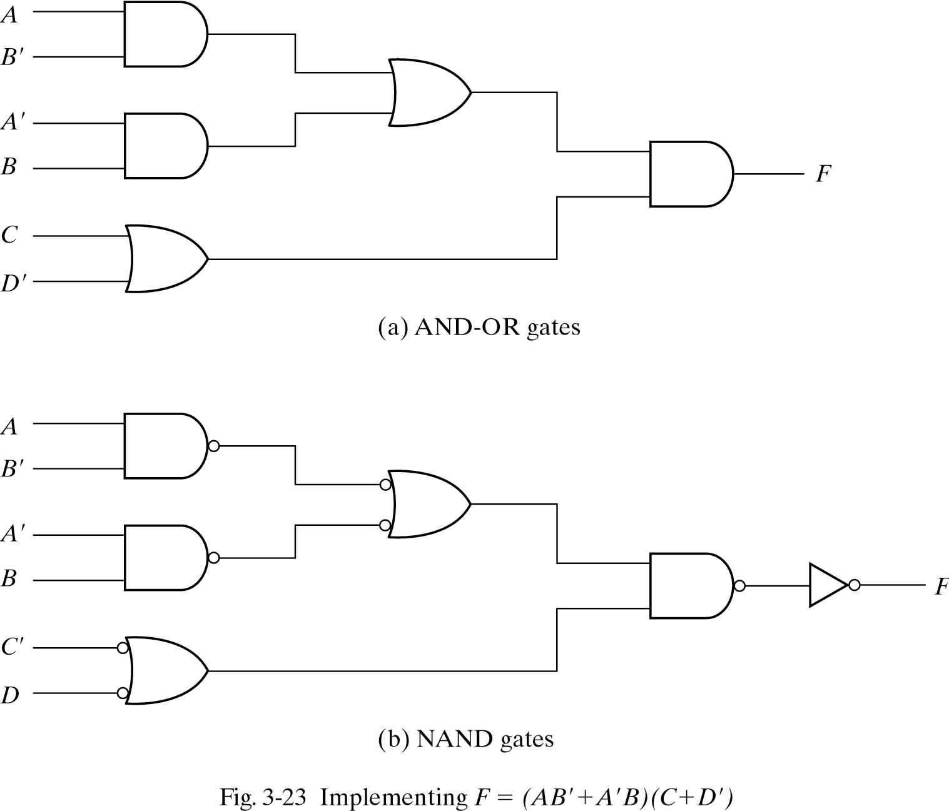
Multilevel NAND circuits

Slide 19
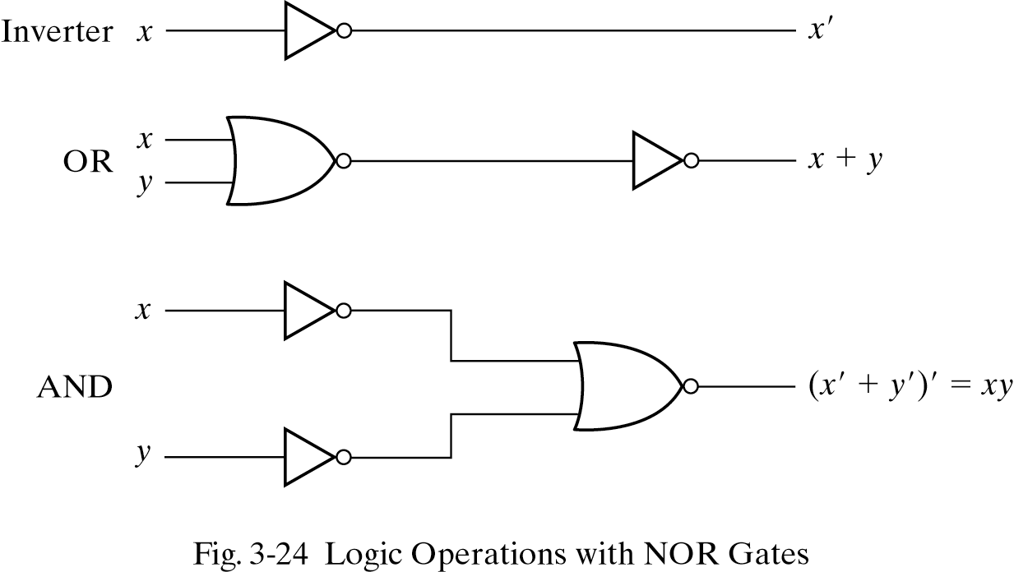
NOR implementation
NOR is NAND dual so all NOR rules are dual of NAND rules.
All designs can be made by NORs

Slide 20
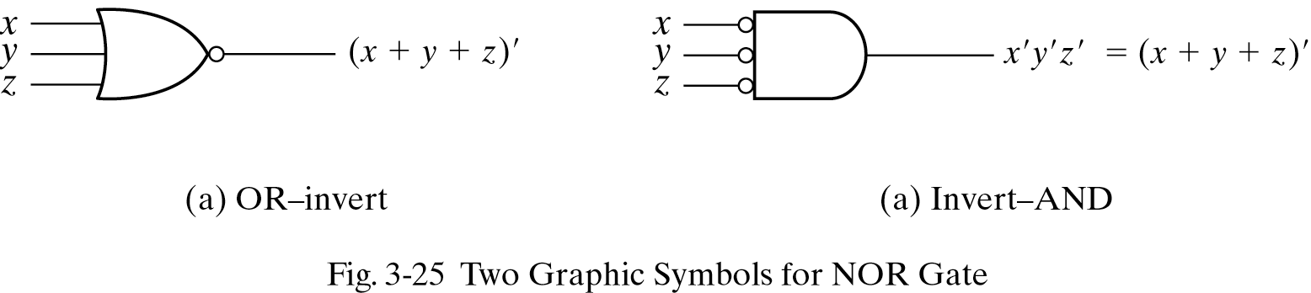
NOR symbols
NOR implementation requires the function expressed in product of sums
NOR implementation Rules
1-Convert all ORs to NOR gates with OR-invert symbol
2-Convert all ANDs to NOR gates with invert-AND symbols
3-Check the bubbles, insert bubble

Slide 21
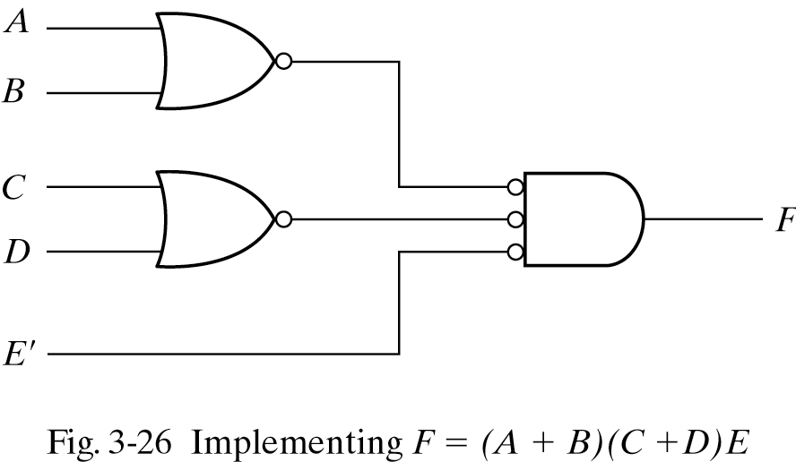
NOR circuits

Slide 22
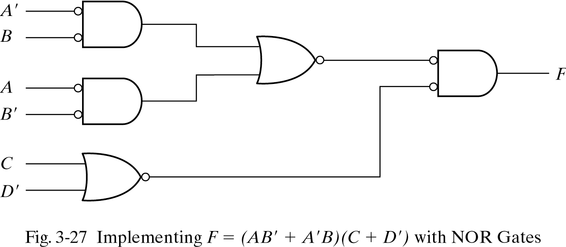
NAND and NOR gate

Slide 23
Summary
NAND and NOR implementations
Gate-level Minimization, Implementation

